Slide 1
Monitoring and Analysis
Christopher Parnin

Slide 2
Overview
Monitoring
Flame Graphs
Simian Army

Slide 3
Discussion
What would you monitor in an application?

Slide 4
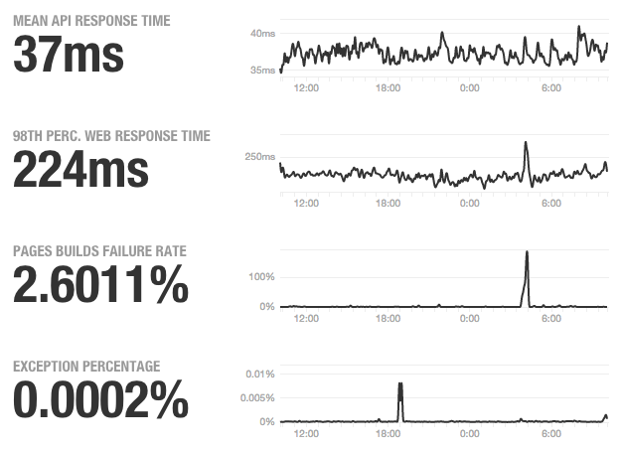
Github status spike
Some metrics after recent DDOS attack at github.
https://status.github.com/
3/28/15

Slide 5
Monitoring Strategy
Instrumentation of applications and your infrastructure
Storing data retrievable for analysis
Creating dashboards which aggregate and present data suitable for business/operations.
Setting up notifications for the right people

Slide 6
Places to Collect Data
Hardware (via SNMP)
voltages, temperatures, fan speeds, peripheral health
Operating System
memory usage, swap usage, disk space, I/O bandwidth, CPU load
Middleware
memory, thread/db connection pools, connections, response time
Applications
business transactions, value, conversion rate, external third party status.

Slide 7
Green-Amber-Red Light
Monitoring Framework based on Nygard 2007:
Green:
All expected events occurred
No abnormal events
All metrics nominal
All states operational

Slide 8
Green-amber-red light
Amber:
An expected event has not occurred
At least one abnormal event, with medium severity
One or more metric out of nominal range
A noncritical state not fully operational

Slide 9
Green-amber-red light
Red:
A required event has not occurred
At least one abnormal event, with high severity
One or more metric far out of nominal range
A critical state not fully operational

Slide 10
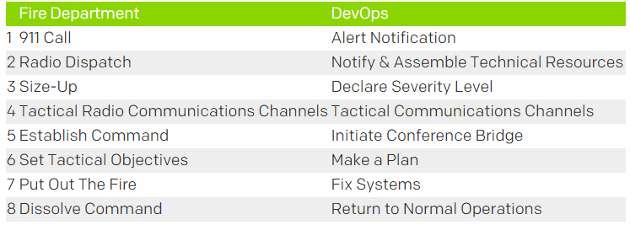
Incident Management
Inspired by fire department emergency response.

Slide 11
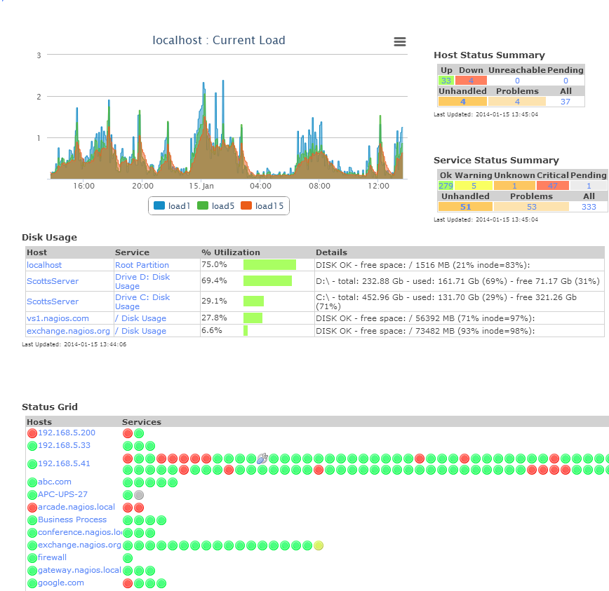
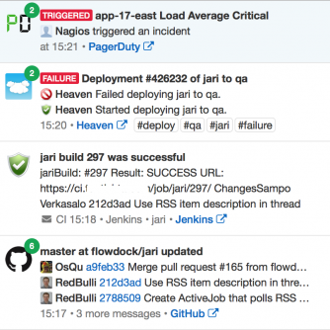
Dashboard

Slide 12
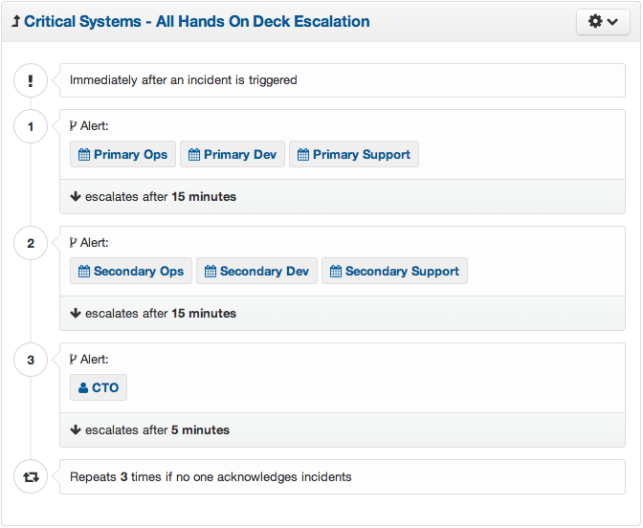
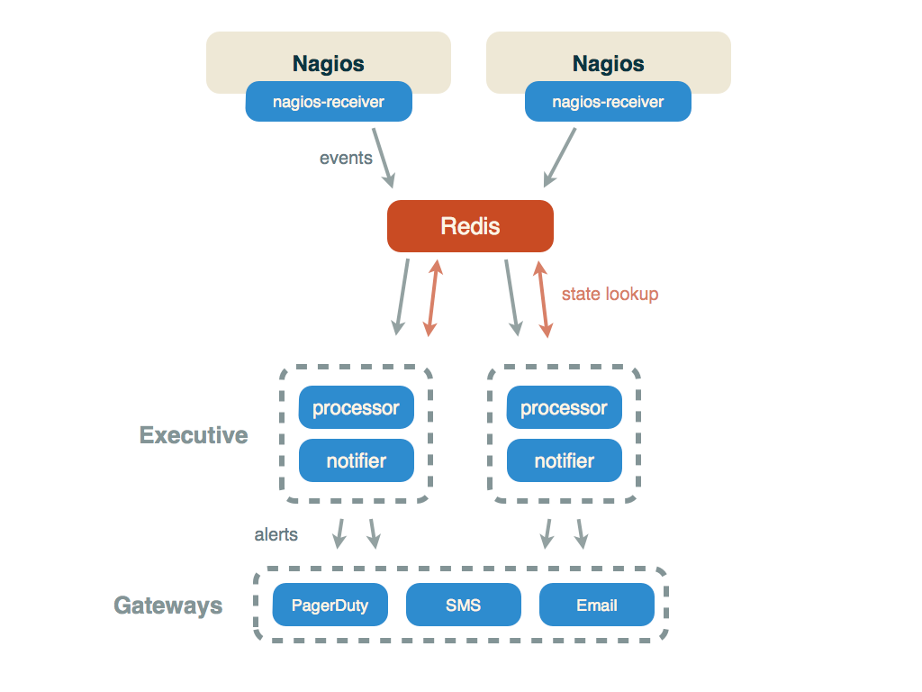
Notifications

Slide 13
Behavior Metrics
UX Metrics
Happiness
Engagement
Adoption
Retention
Task Success
http://www.dtelepathy.com/ux-metrics/?utm_content=buffer90f37

Slide 14
Tools supporting Monitoring
Nagios
OpenNMS
Flapjack
Zenoss
Operations Manager
Tivoli
Splunk
PagerDuty
serverdensity.com

Slide 15
Discussion
How would you use these concepts in your project?

Slide 16
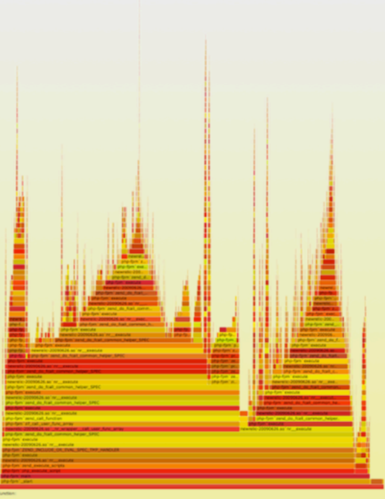
Flame Graphs
Created by
Brendan Gregg,
author of dtrace.
See for more details:
https://www.usenix.org/sites/default/files/conference/protected-files/gregg_lisa13_flamegraphs.pdf

Slide 17
# dtrace -x ustackframes=100 -n 'profile-997 /execname == "mysqld"/ { @[ustack()] = count(); } tick-60s { exit(0); }'
dtrace: description 'profile-997 ' matched 2 probes
CPU ID FUNCTION:NAME 1 75195 :tick-60s
libc.so.1`__priocntlset+0xa libc.so.1`getparam+0x83 libc.so.1`pthread_getschedparam+0x3c libc.so.1`pthread_setschedprio+0x1f mysqld`_Z16dispatch_command19enum_server_commandP3THDPcj+0x9ab mysqld`_Z10do_commandP3THD+0x198 mysqld`handle_one_connection+0x1a6 libc.so.1`_thrp_setup+0x8d libc.so.1`_lwp_start
mysqld`_Z13add_to_statusP17system_status_varS0_+0x47 mysqld`_Z22calc_sum_of_all_statusP17system_status_var+0x67 mysqld`_Z16dispatch_command19enum_server_commandP3THDPcj+0x1222 mysqld`_Z10do_commandP3THD+0x198 mysqld`handle_one_connection+0x1a6 libc.so.1`_thrp_setup+0x8d libc.so.1`_lwp_start

Slide 18
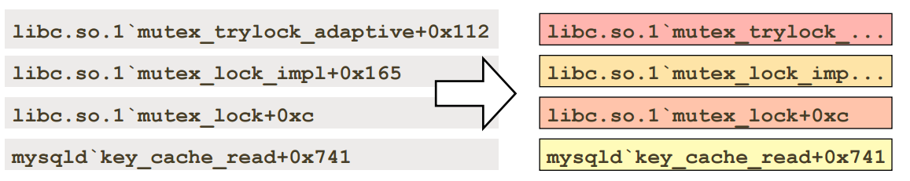
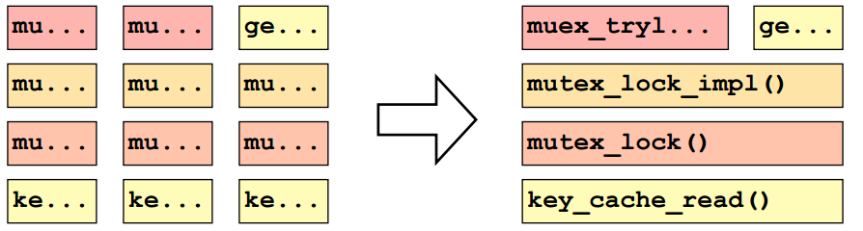
Construction
Map stack frame to rectangle, color is random
Merge adjacent functions, sort x-axis alphabetically

Slide 19
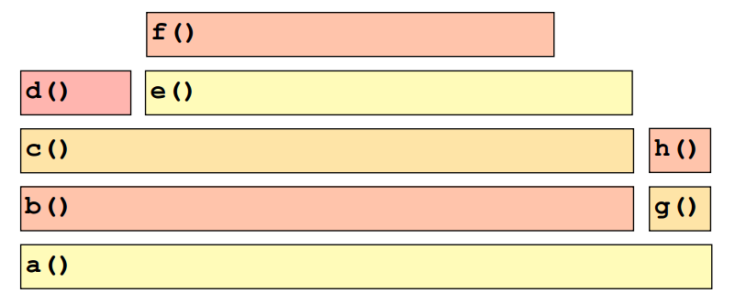
Reading a flame graph
Which function is running on CPU the most?

Slide 20
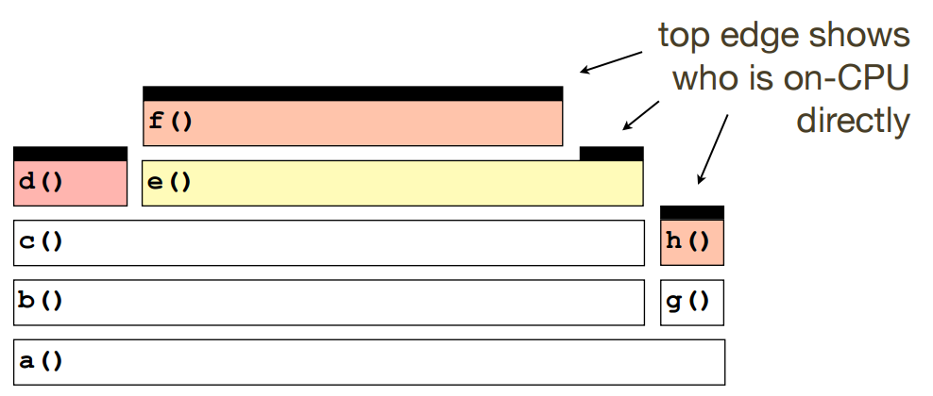
Reading a flame graph
f()!

Slide 21
Flames rising at Netflix
We noticed that request latencies to our Node.js application would increase progressively with time. Specifically, some of our endpoints’ latencies would start at 1ms and increase by 10ms every hour. We also saw a correlated increase in CPU usage
http://techblog.netflix.com/2014/11/nodejs-in-flames.html

Slide 22
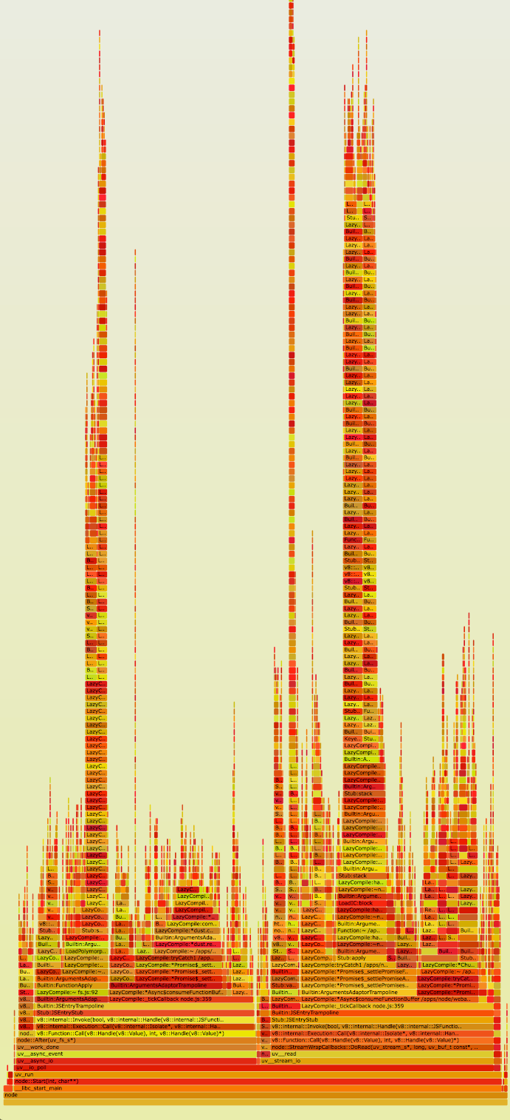
What’s wrong?
Immediately, we see incredibly high stacks in the application (y-axis). We also see we’re spending quite a lot of time in those stacks (x-axis).
On closer inspection, it seems the stack frames are full of references to Express.js’s router.handle and router.handle.next functions.

Slide 23
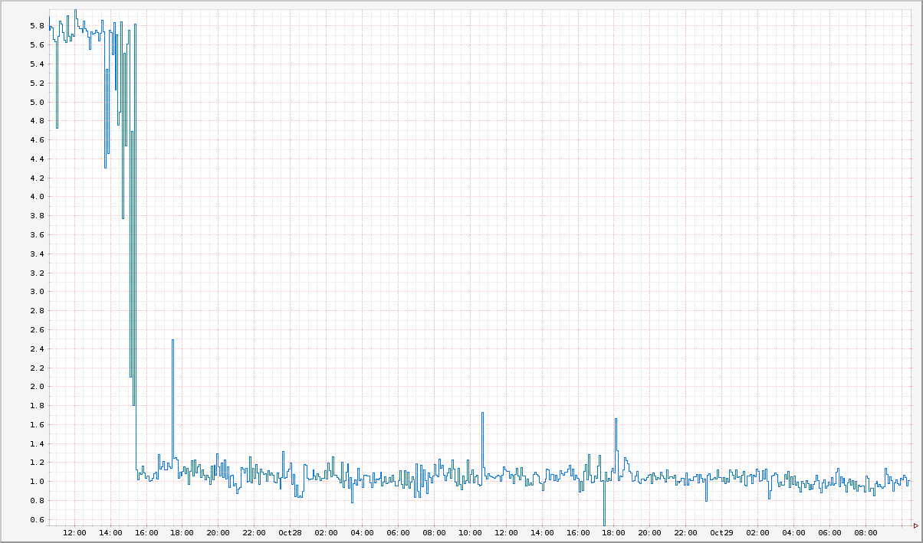
The fix
Something was adding the same Express.js provided static route handler 10 times an hour.
This turned out be caused by a periodic (10/hour) function in our code... Unfortunately, it was also inadvertently adding a static route handler with the same path each time it ran.

Slide 24
Discussion
What are some other things you can use a flame graph for?

Slide 25

Simian Army
“The name comes from the idea of unleashing a wild monkey with a weapon in your data center”
http://www.infoq.com/presentations/netflix-resiliency-failure-cloud
http://techblog.netflix.com/2011/07/netflix-simian-army.html

Slide 26

Chaos Monkey
Randomly,
disrupt any instance
in your infrastructure.

Slide 27
Lessons Learned
State is bad
Clusters are good
Surviving single instance failure is not enough

Slide 28

Chaos Gorilla
Simulates an outage
of an entire Amazon
availability zone.

Slide 29
Lessons Learned
Infrastructure control can be a bottleneck
Hidden assumptions on deployment topology
Large scale events hard to simulate
Rapidly shifting traffic is error-prone

Slide 30

Latency Monkey
Artificial delays in our RESTful client-server communication layer to simulate service degradation and measures if upstream services respond appropriately

Slide 31
Lessons Learned
Startup resiliency is often missed
Unified approach to runtime dependency management important
Fallbacks can fail too

Slide 32

Janitor Monkey
Searches for unused resources and disposes of them.

Slide 33
Lessons Learned
Label everything (do we need this?)
Clutter builds up (if you don’t stop it soon, you will have to deal with bigger problems)
System entropy:
Cruft
Vulnerabilities
Cost
Complexity

Slide 34
Others
Doctor Monkey taps into health checks that run on each instance as well as monitors other external signs of health (e.g. CPU load) to detect unhealthy instances. Once unhealthy instances are detected, they are removed from service and after giving the service owners time to root-cause the problem, are eventually terminated.
Conformity Monkey finds instances that don’t adhere to best-practices and shuts them down. For example, we know that if we find instances that don’t belong to an auto-scaling group, that’s trouble waiting to happen. We shut them down to give the service owner the opportunity to re-launch them properly.
Security Monkey is an extension of Conformity Monkey. It finds security violations or vulnerabilities, such as improperly configured AWS security groups, and terminates the offending instances. It also ensures that all our SSL and DRM certificates are valid and are not coming up for renewal.
10-18 Monkey (short for Localization-Internationalization, or l10n-i18n) detects configuration and run time problems in instances serving customers in multiple geographic regions, using different languages and character sets.

Slide 35
Discussion
What is a new monkey you might create?

Slide 36
Next
Workshop:
Implementing a few members of the Simian Army.
Dashboard monitoring app status.
More Special Milestone Ideas
Implement a flame graph
Implement a new Simian monkey.

